Slide 1


Motor insurance market Simulation
Michaël Bordeleau
March 21st, 2021

Slide 2




Hi!
34 years old
Montréal, Québec, Canada
« Typical » Actuary
Home & Auto Insurance
working with GLMs

Slide 3





Hi (pt.2)!
Working within a Research & Development team
Young Data Scientists
All skillful in Python and R
Have been watching the parade from the sidelines…
This competition was my motivation at learning R and initiate a journey into machine learning

Slide 4
Competition

Slide 5
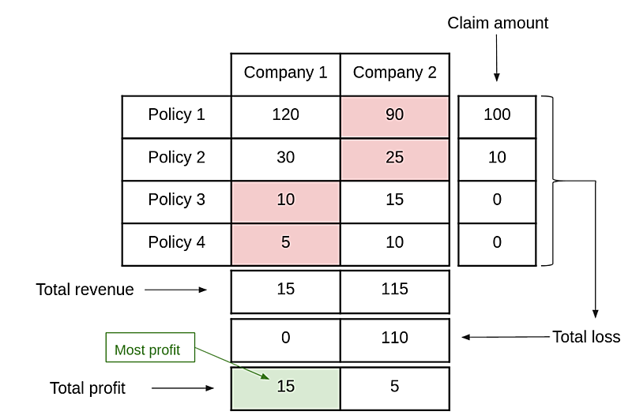


GOAL
You are an insurance company, building a pricing model, and compete against other insurers for profit.
Clients pick lowest price quote.
Insurer with most profit wins.

Slide 6
Data
 | POLICY | DRIVER(S) | VEHICLE | GEOGRAPHY
id_policy | coverage | gender | make model (hash) | population
year (1-4) | age | age | age | town surface area
claim amount | payment frequency | years licensed | usage type
 | ppv vs commercial | no claims discount | fuel
 | telematics (y/n) |  | speed
 |  |  | weight
 |  |  | value (as new)
From an European insurer
57,054 policies x 4 years = 228,216 rows
Note that there’s no variable tracking past claim counts and amounts

Slide 7

Feature engineering
Go crazy

Slide 8


Transformations
Population Density = Population / Surface Area
Actual Vehicle Value :: exponential depreciation
with reversal for very old vehicles, “collectibles”

Slide 9
interactions
Driver
Policy
Vehicle
Geography
thorough thinking about the variables and how it could influence the risk

Slide 10
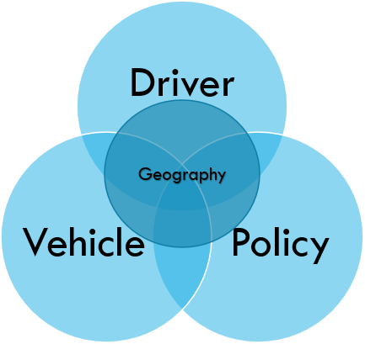
interactions :: Assumptions
Young/Inexperienced driver with a faster vehicle can be more risky
Young/Inexperienced driver with a heavier vehicle can be more risky
Young/Inexperienced driver with an expensive vehicle can be more risky
Young/Inexperienced driver in a densified city can be more risky
or brute force :: create all possible ratio combinations
Variables x1, x2, x3, … xn.
x1/x2 , x1/x3 , x1/xn , … x2/x3 , x3/x4 , …
x1- x2 , x1- x3 , x1- xn , … x2- x3 , x2- x4 , …

Slide 11
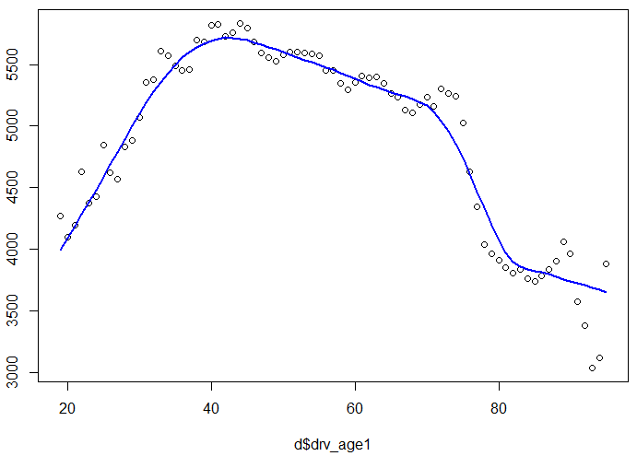
You vs the world
Are you driving a vehicle that is much more expensive/ or less than your friend?
Measure the distance between: . your vehicle value . the smoothed average vehicle value (blue line), at your age
Reflects client behavior, frugality?
vh_value

Slide 12
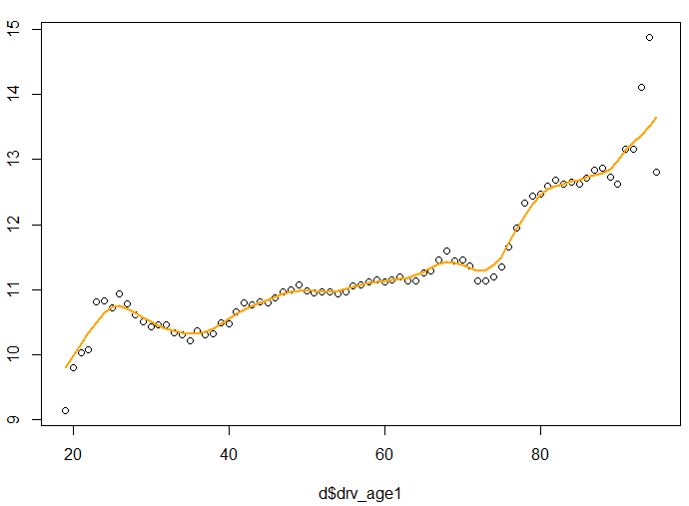
You vs the world
Are you driving a much newer or older vehicle than your friend?
Made selections on smoothing coefficient
And so on…
vh_age

Slide 13
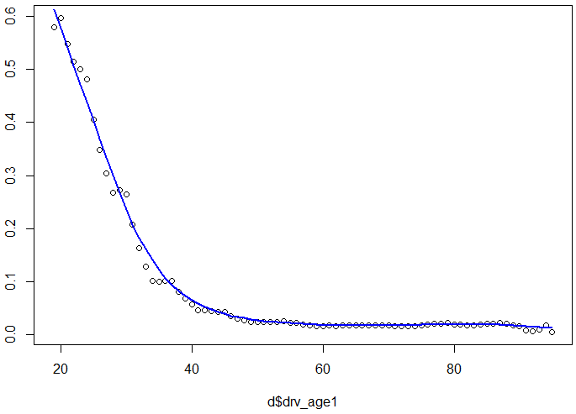
You vs the world
Do you have a much better or worse No Claims Discount than your friend?

Slide 14
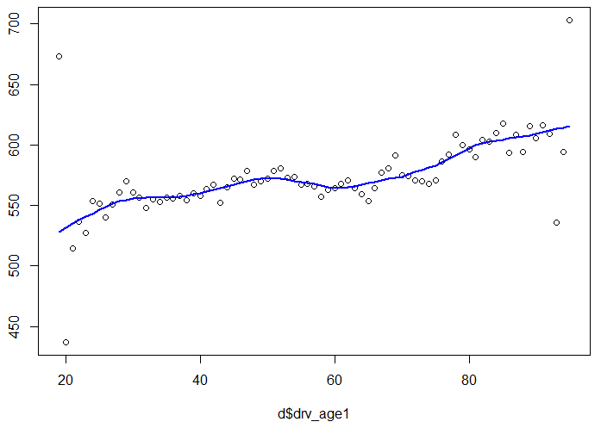
You vs the world
Are you living in a much more populous city than your friend?
… and so on.
Repeated same exercise by Driver Experience (Number of Years Licensed)
population

Slide 15

I know what you did last Summer
Created features based on your own history with the insurer
Have you switched vehicle?
Have you moved to a new city?
Have you modified your insurance coverage?
Have you changed your payment frequency?
How has your No Claims Discount evolved?
Did you claim and how much money have I been giving you?!!?

Slide 16
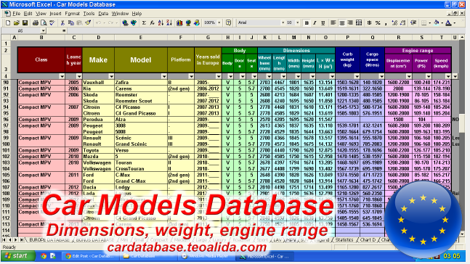

get some edge?
External Database
Merge using Speed & Weight
Cross-check reasonableness by comparing popularity of vehicle
Get engine specs, …
Profit?
$110 USD

Slide 17

Categorical Variables :: one-hot encoding
Policy Coverage has 4 levels
Max
Med2
Med1
Min
Replace with 4 binary variables:
pol_coverage.max 0 or 1
pol_coverage.med2 0 or 1
pol_coverage.med1 0 or 1
pol_coverage.min 0 or 1
For models sensitive to collinearity (ie. GLMs), preferable to leave one out
Avoids the “Dummy Variable Trap”

Slide 18

Categorical variables :: TARGET ENCODING
Use insights from the response variable (claim amount) to transform into a numerical value
Policy Coverage has 4 levels
Max
Med2
Med1
Min
In terms of frequency and severity of claims,
Max looked higher risk than Med2, which was riskier than Med1 which was riskier than Min.
Replace with a numerical value* correlated with the risk.
Max ➔ 4
Med2 ➔ 3
Med1 ➔ 2
Min ➔ 1

Slide 19

Categorical variables :: TARGET ENCODING
You can target encode using various type of values:
Mean
Median
Order
However, beware of …

Slide 20
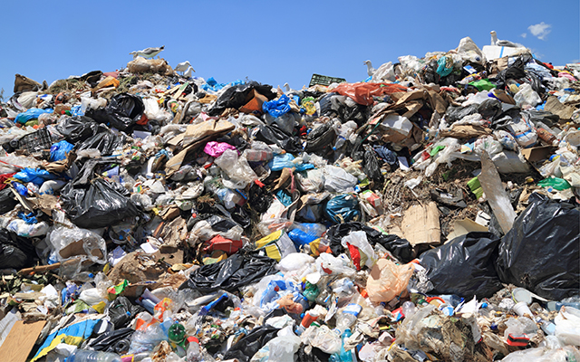
Leakage
Garbage in, Garbage out

Slide 21

Leakage
As I progressed in the competition, I saw my public RMSE score deteriorate
If you do too much target encoding, you WILL experience leakage
Model performs great in cross-validation but will be useless on new data

Slide 22

Leakage
For Vehicle Make Model, I did some mean target encoding
with heavy smoothing
still ended up having leakage
Ultimately, the only feature I kept was a Vehicle “Popularity” index
Quantify the “Popularity” of a Vehicle in the population. Heavy rounding.
Index ranging from 1 to 78
Rational:
A Popular Vehicle could be cheaper to repair due to broader parts availability, and vice-versa

Slide 23

Claim amount, year and inflation
Originally had capped losses at $45,000
Not effort was put into analyzing large losses
Selected inflation rate per year
Inflated all losses up to T = 4
Dropped the year variable
I didn’t want year to be used as a feature in any of my models

Slide 24

Modeling
You get a model, you get a model, everyone gets a model

Slide 25

Models
18 different models to tune
12 different prediction models
xgboost
catboost
lightgbm
random forest
glm
glmnet
frequency x severity
loss cost (tweedie)

Slide 26


Models
For GLMs, dimensionality reduction using Principal Components Analysis
Hyperparameters Tuning using Grid Search and Parallel Processing

Slide 27


Stacking
18 base models
+ 4 meta models
22 models tuned
. To improve claims prediction
. 4 meta-learning models
. Trained on top of all the models developed
. xgboost
. lightgbm
. random forest
. neural network
. Final is an average of the 4

Slide 28
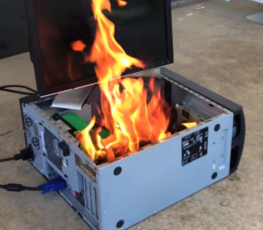
market Simulation
Another way to heat up your house in winter!

Slide 29
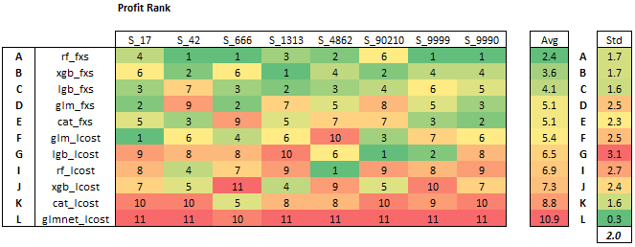
Market simulation
Using 11 models, trained 8 different times (new seeds)
8 different 70 train / 30 hold out.
There’s no model winning systematically

Slide 30
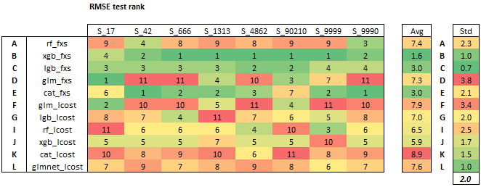
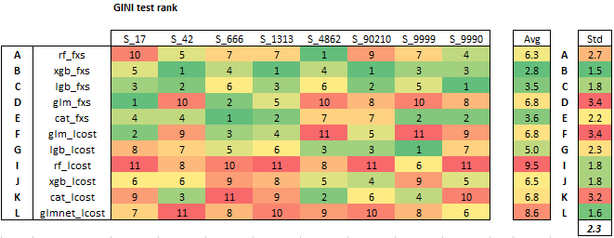
Market simulation
Understanding loss functions and its correlation with profit

Slide 31
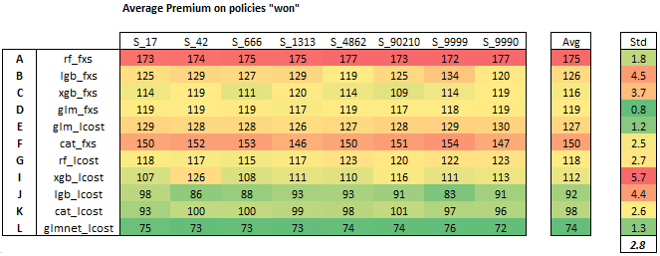
Market simulation
Understanding that models have natural tendency to win different segments

Slide 32
Profit Loading
Bringing home the bacon!

Slide 33

Time wasted…
Spent 10 weeks working on:
Features
Models
Simulation
Spent 2 minutes on profit loading
Had no idea how to adequately load my prices
Didn’t find much value in the Weekly Feedback beside Market Share %
Had to improvise

Slide 34

Leaderboard progress
Week | Teams | Position | Profit | Market Share
1 | 44 | -- | -- | --
2 | 81 | 67 | -271,294 | 44 %
3 | 107 | 107 | Overcharged | --
4 | 142 | 90 | -118,561 | 20 %
5 | 168 | 14 | -323 | 0.4 %
6 | 191 | 8 | 6,420 | 19 %
7 | 207 | 61 | -53,298 | 18 %
8 | 220 | 43 | -11,015 | 17 %
9 | 247 | 99 | -14,548 | 11 %
10 | 259 | 8 | 9,296 | 13 %
Each week is independent

Slide 35
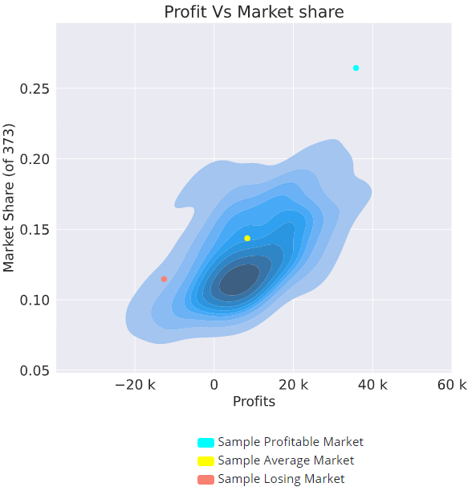
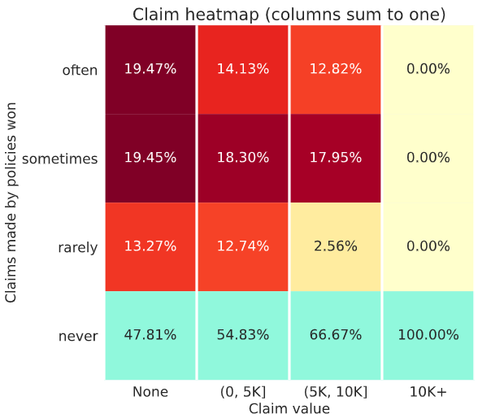
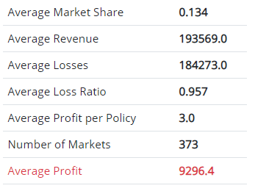
Feedback (week 10)

Slide 36



Minimum loading to achieve profitability?
Recycling market simulation, building markets of 10 “insurers”
Recursively identified the minimal loading required
so that all 10 insurers end up profitable
Highly volatile results… between 25% and 40% loading required
Looks high… I should aim a little lower
I need to expect, and desire, that some insurers will lose money…
Also noted that without any loading, insurers would have on average 120% loss ratio

Slide 37

Profit loading
Two loadings:
.Variable Loading. proportional to the expected claim
Vc = 1.149
.Variable Loading. partially proportional to the odds of having a claim
Vf = 1 + E[frequency] x 63%
Premium = E[Claims] x Vc x Vf
Loading distribution:

Slide 38


End game
Quote 100,000 policies at year 5
43 % are new clients
57 % are clients from the training data (year 1-4)
Submitted a zip file hosting 2 models:
Model A : generalized model fitting to all business*
Model B : data-augmented model fitting to known clients
saved past claim counts & amounts from the training data
fed it to the quoting process
Cherry picking

Slide 39




RESULTS
252 teams between 300 and 400 participants
43e Simon Coulombe
37e Sylvain Demars
21e Maxime Comeau
4e Michaël Bordeleau
2e Guillaume Lepage

Slide 40

Thank you
Questions?
linkedin.com/in/mbordeleau

